Slide 1
Linear Regression
Prof. Antonio Tavernard

Slide 2






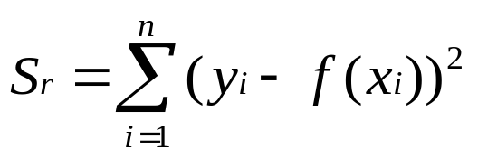

What is Regression?
What is regression? Given n data points
best fit
to the data. The best fit is generally based on
minimizing the sum of the square of the residuals,
.
Residual at a point is
Sum of the square of the residuals
Figure. Basic model for regression

Slide 3









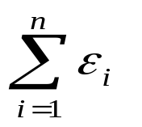

Linear Regression-Criterion#1
Given n data points
best fit
to the data.
y
x
Figure. Linear regression of y vs. x data showing residuals at a typical point, x_{i} .
Does minimizing
work as a criterion, where

Slide 4
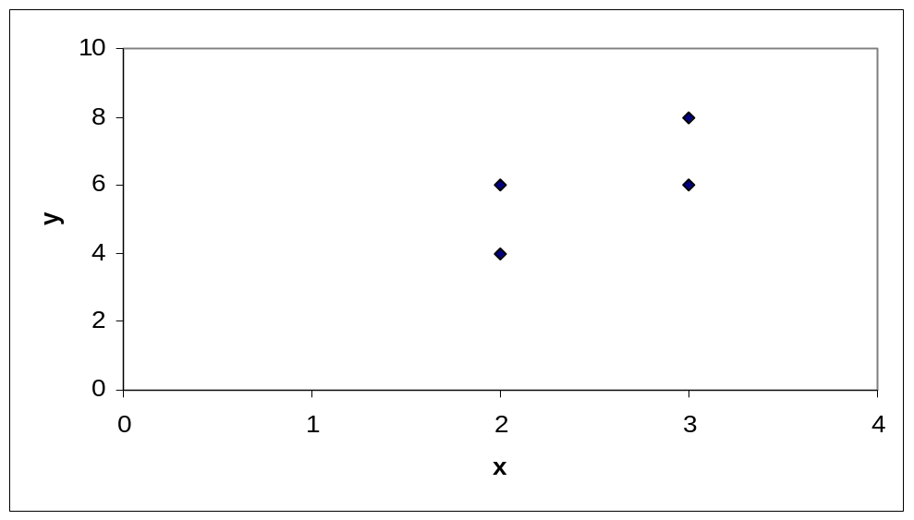
Example for Criterion#1
Example: Given the data points (2,4), (3,6), (2,6) and (3,8), best fit the data to a straight line using Criterion#1
Table. Data Points
x | y
2.0 | 4.0
3.0 | 6.0
2.0 | 6.0
3.0 | 8.0
Figure. Data points for y vs. x data.

Slide 5
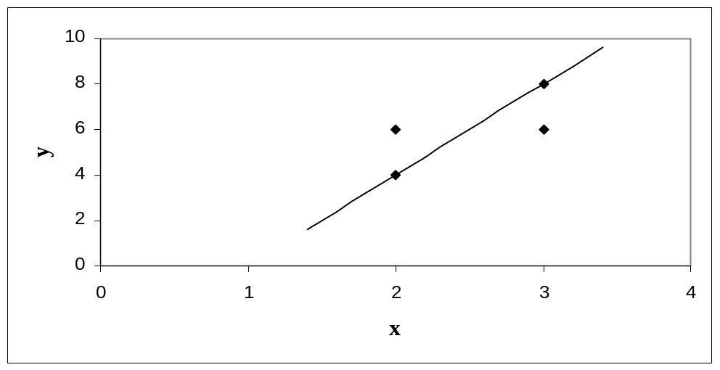
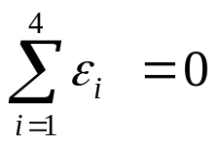
Linear Regression-Criteria#1
Using y=4x-4 as the regression curve
Table. Residuals at each point for regression model y = 4x – 4.
x | y | y_{predicted} | ε = y - y_{predicted}
2.0 | 4.0 | 4.0 | 0.0
3.0 | 6.0 | 8.0 | -2.0
2.0 | 6.0 | 4.0 | 2.0
3.0 | 8.0 | 8.0 | 0.0
Figure. Regression curve for y=4x-4, y vs. x data

Slide 6
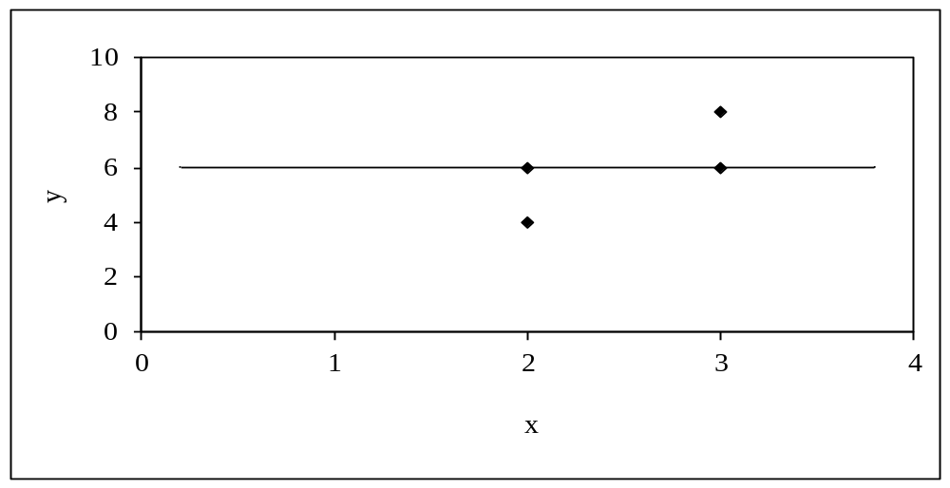
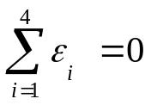
Linear Regression-Criteria#1
Using y=6 as a regression curve
Table. Residuals at each point for y=6
x | y | y_{predicted} | ε = y - y_{predicted}
2.0 | 4.0 | 6.0 | -2.0
3.0 | 6.0 | 6.0 | 0.0
2.0 | 6.0 | 6.0 | 0.0
3.0 | 8.0 | 6.0 | 2.0
Figure. Regression curve for y=6, y vs. x data

Slide 7
Linear Regression – Criterion #1
for both regression models of y=4x-4 and y=6.
The sum of the residuals is as small as possible, that is zero, but the regression model is not unique.
Hence the above criterion of minimizing the sum of the residuals is a bad criterion.

Slide 8
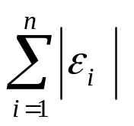
Linear Regression-Criterion#2
Will minimizing
work any better?
y
x
Figure. Linear regression of y vs. x data showing residuals at a typical point, x_{i} .

Slide 9
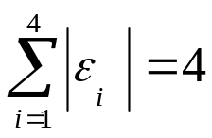
Linear Regression-Criteria 2
Using y=4x-4 as the regression curve
Table. The absolute residuals employing the y=4x-4 regression model
x | y | y_{predicted} | |ε| = |y - y_{predicted}|
2.0 | 4.0 | 4.0 | 0.0
3.0 | 6.0 | 8.0 | 2.0
2.0 | 6.0 | 4.0 | 2.0
3.0 | 8.0 | 8.0 | 0.0
Figure. Regression curve for y=4x-4, y vs. x data

Slide 10
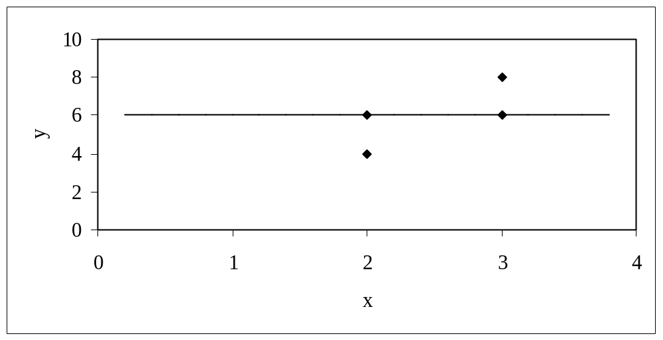
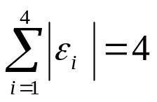
Linear Regression-Criteria#2
Using y=6 as a regression curve
Table. Absolute residuals employing the y=6 model
x | y | y_{predicted} | |ε| = |y – y_{predicted}|
2.0 | 4.0 | 6.0 | 2.0
3.0 | 6.0 | 6.0 | 0.0
2.0 | 6.0 | 6.0 | 0.0
3.0 | 8.0 | 6.0 | 2.0
Figure. Regression curve for y=6, y vs. x data

Slide 11
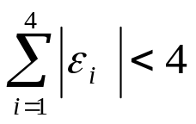
Linear Regression-Criterion#2
for both regression models of y=4x-4 and y=6.
The sum of the errors has been made as small as possible, that is 4, but the regression model is not unique.
Hence the above criterion of minimizing the sum of the absolute value of the residuals is also a bad criterion.
Can you find a regression line for which
and has unique
regression coefficients?

Slide 12
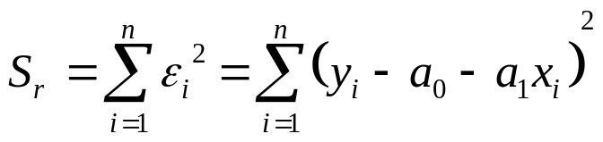
Least Squares Criterion
The least squares criterion minimizes the sum of the square of the residuals in the model, and also produces a unique line.
y
x
Figure. Linear regression of y vs. x data showing residuals at a typical point, x_{i} .

Slide 13




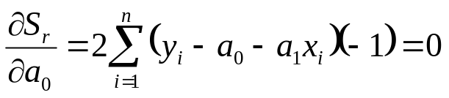
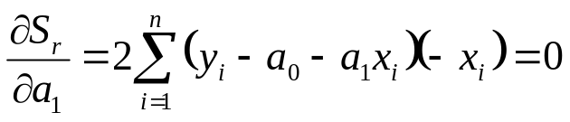
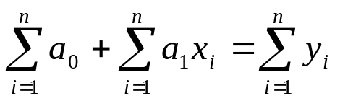

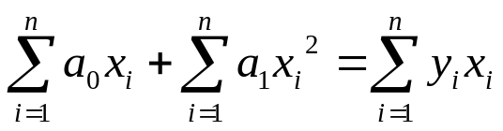
Finding Constants of Linear Model
Minimize the sum of the square of the residuals:
To find
and
we minimize
with respect to
and
.
giving

Slide 14
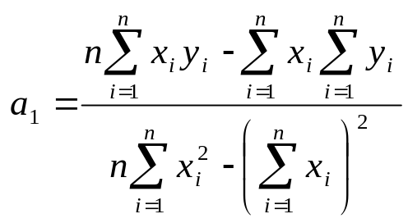
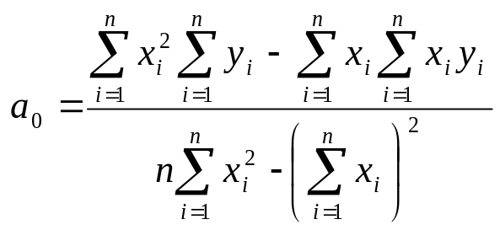

Finding Constants of Linear Model
Solving for
and
directly yields,
and

Slide 15

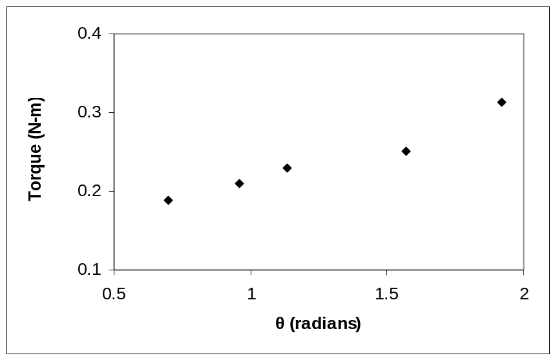
Example 1
The torque, T needed to turn the torsion spring of a mousetrap through an angle, is given below.
Find the constants for the model given by
Table: Torque vs Angle for a torsional spring
Angle, θ | Torque, T
Radians | N-m
0.698132 | 0.188224
0.959931 | 0.209138
1.134464 | 0.230052
1.570796 | 0.250965
1.919862 | 0.313707
Figure. Data points for Angle vs. Torque data

Slide 16





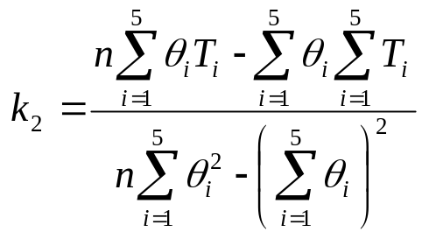
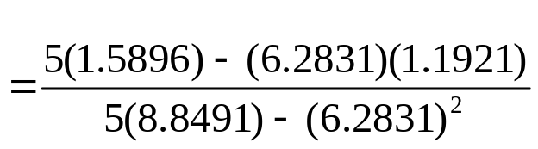
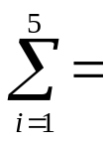

Example 1 cont.
The following table shows the summations needed for the calculations of the constants in the regression model.
Table. Tabulation of data for calculation of important
summations
Radians | N-m | Radians² | N-m-Radians
0.698132 | 0.188224 | 0.487388 | 0.131405
0.959931 | 0.209138 | 0.921468 | 0.200758
1.134464 | 0.230052 | 1.2870 | 0.260986
1.570796 | 0.250965 | 2.4674 | 0.394215
1.919862 | 0.313707 | 3.6859 | 0.602274
6.2831 | 1.1921 | 8.8491 | 1.5896
Using equations described for
and
with
N-m/rad

Slide 17

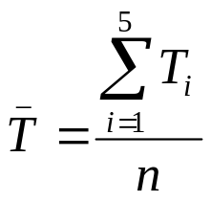
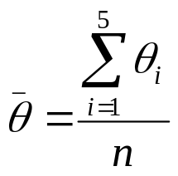
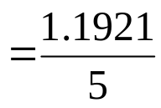
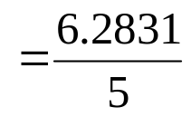


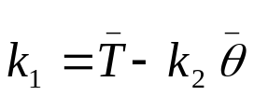

Example 1 cont.
Use the average torque and average angle to calculate
Using,
N-m

Slide 18
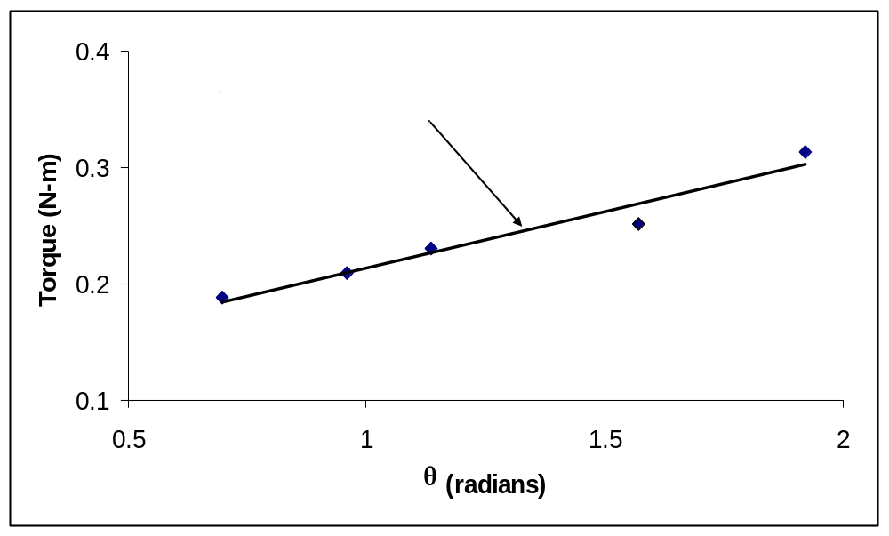
Example 1 Results
Using linear regression, a trend line is found from the data
Figure. Linear regression of Torque versus Angle data
Can you find the energy in the spring if it is twisted from 0 to 180 degrees?

Slide 19


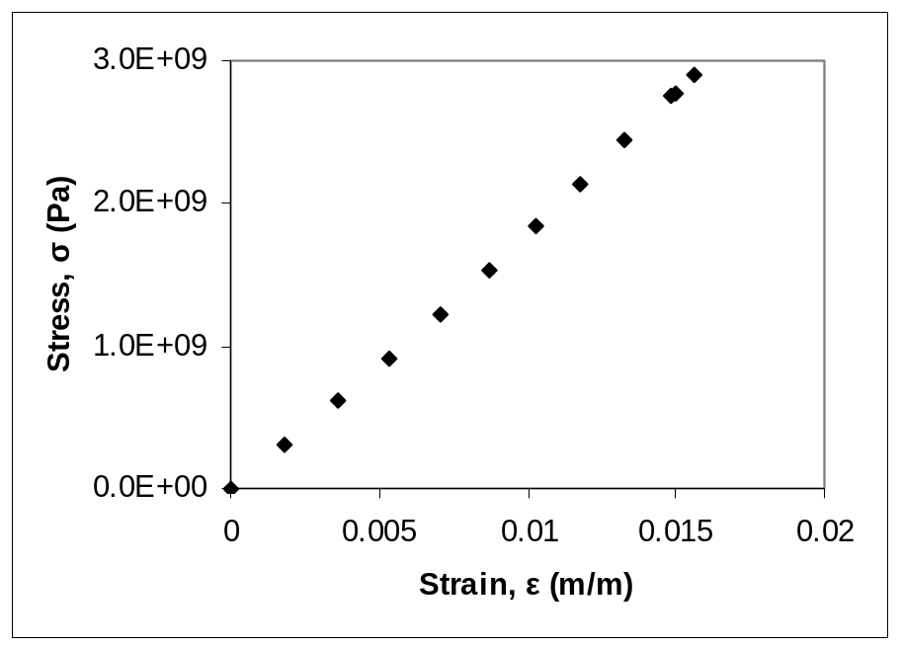
Example 2
To find the longitudinal modulus of composite, the following data is collected. Find the longitudinal modulus,
using the regression model
Table. Stress vs. Strain data
and the sum of the square of the
Strain | Stress
(%) | (MPa)
0 | 0
0.183 | 306
0.36 | 612
0.5324 | 917
0.702 | 1223
0.867 | 1529
1.0244 | 1835
1.1774 | 2140
1.329 | 2446
1.479 | 2752
1.5 | 2767
1.56 | 2896
residuals.
Figure. Data points for Stress vs. Strain data

Slide 20

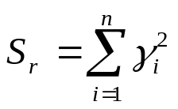
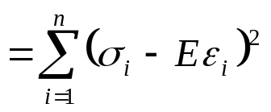

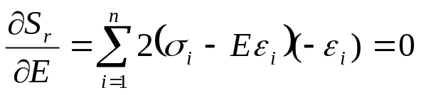
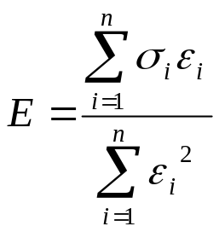
Example 2 cont.
Residual at each point is given by
The sum of the square of the residuals then is
Differentiate with respect to
Therefore

Slide 21
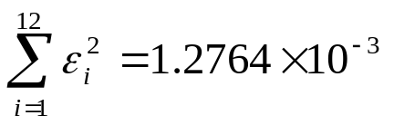
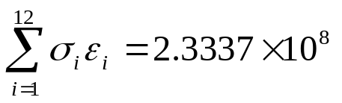
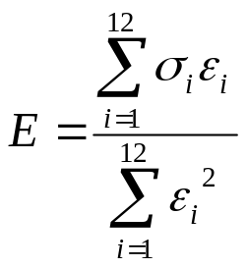
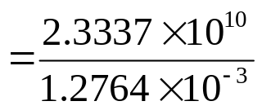


Example 2 cont.
Table. Summation data for regression model
With
i | ε | σ | ε ² | εσ
1 | 0.0000 | 0.0000 | 0.0000 | 0.0000
2 | 1.8300x10⁻³ | 3.0600x10⁸ | 3.3489x10⁻⁶ | 5.5998x10⁵
3 | 3.6000x10⁻³ | 6.1200x10⁸ | 1.2960x10⁻⁵ | 2.2032x10⁶
4 | 5.3240x10⁻³ | 9.1700x10⁸ | 2.8345x10⁻⁵ | 4.8821x10⁶
5 | 7.0200x10⁻³ | 1.2230x10⁹ | 4.9280x10⁻⁵ | 8.5855x10⁶
6 | 8.6700x10⁻³ | 1.5290x10⁹ | 7.5169x10⁻⁵ | 1.3256x10⁷
7 | 1.0244x10⁻² | 1.8350x10⁹ | 1.0494x10⁻⁴ | 1.8798x10⁷
8 | 1.1774x10⁻² | 2.1400x10⁹ | 1.3863x10⁻⁴ | 2.5196x10⁷
9 | 1.3290x10⁻² | 2.4460x10⁹ | 1.7662x10⁻⁴ | 3.2507x10⁷
10 | 1.4790x10⁻² | 2.7520x10⁹ | 2.1874x10⁻⁴ | 4.0702x10⁷
11 | 1.5000x10⁻² | 2.7670x10⁹ | 2.2500x10⁻⁴ | 4.1505x10⁷
12 | 1.5600x10⁻² | 2.8960x10⁹ | 2.4336x10⁻⁴ | 4.5178x10⁷
 |  |  | 1.2764x10⁻³ | 2.3337x10⁸
and
Using

Slide 22

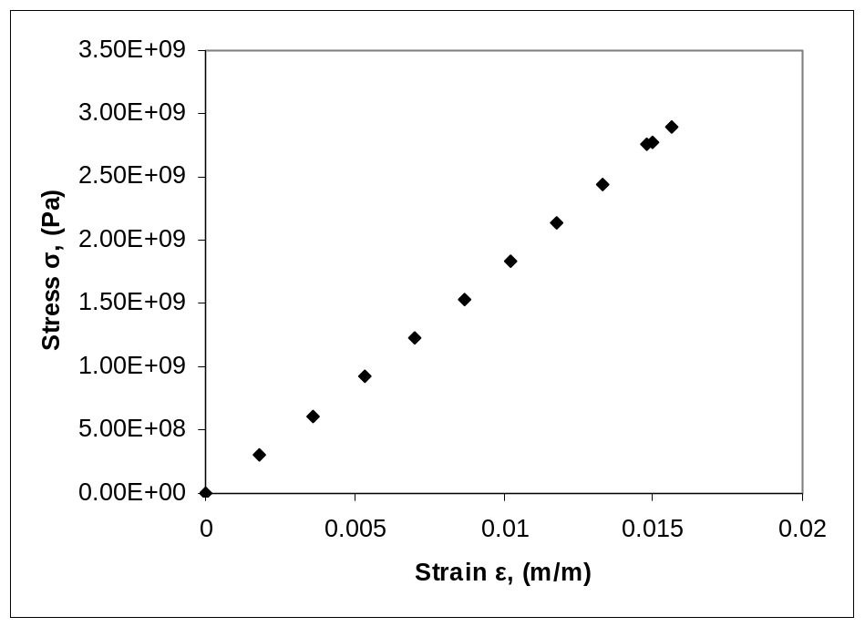
Example 2 Results
The equation
describes the data.
Figure. Linear regression for Stress vs. Strain data

Slide 23
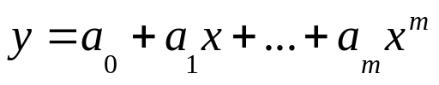




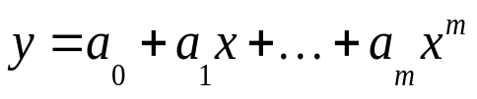


Polynomial Model
Given
best fit
to a given data set.
Figure. Polynomial model for nonlinear regression of y vs. x data

Slide 24

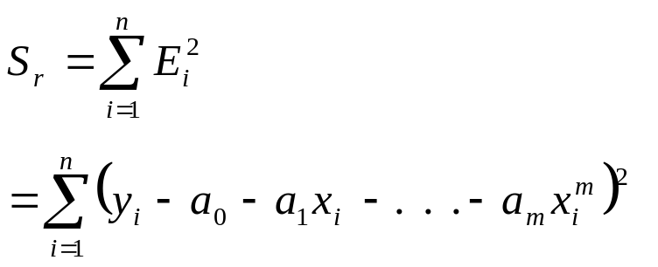
Polynomial Model cont.
The residual at each data point is given by
The sum of the square of the residuals then is

Slide 25


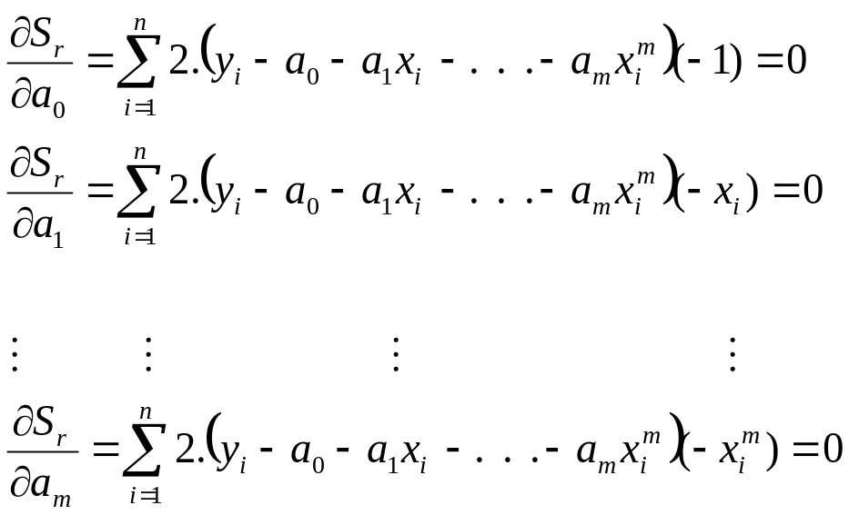
Polynomial Model cont.
To find the constants of the polynomial model, we set the derivatives with respect to
where
equal to zero.

Slide 26
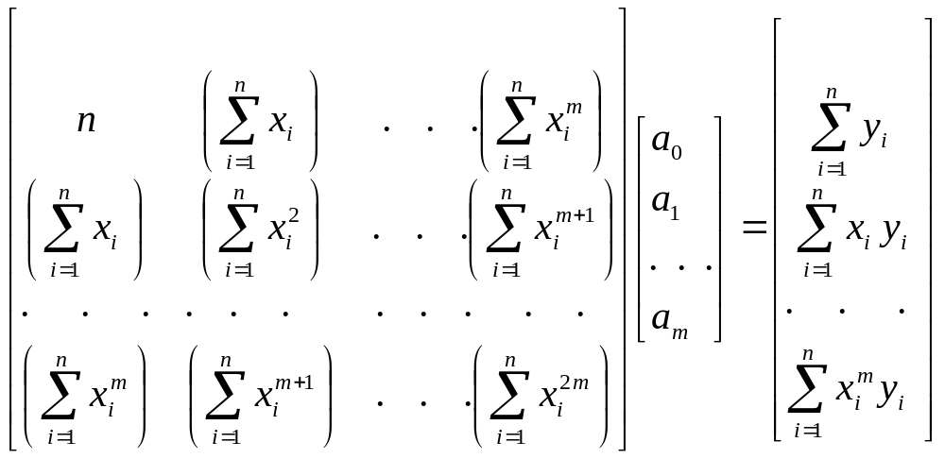

Polynomial Model cont.
These equations in matrix form are given by
The above equations are then solved for

Slide 27
Obrigado!

